Slide 1
What County in the US is the best to live in?
Daniel Adamson
Geoffrey Hoehn
Bryan Ropp

Slide 2
Overview
Trying to find most affordable county with highest quality of life.
Method:
Looking at metrics like life expectancy, median income, median home price, state property taxes, sales taxes, and educational attainment.
Rank each county by these metrics, then add those metrics.
Low scores are advantageous; ranked again by sum of ranks in all metrics.

Slide 3
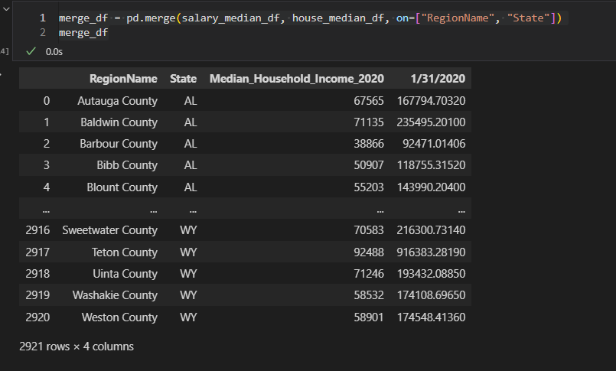
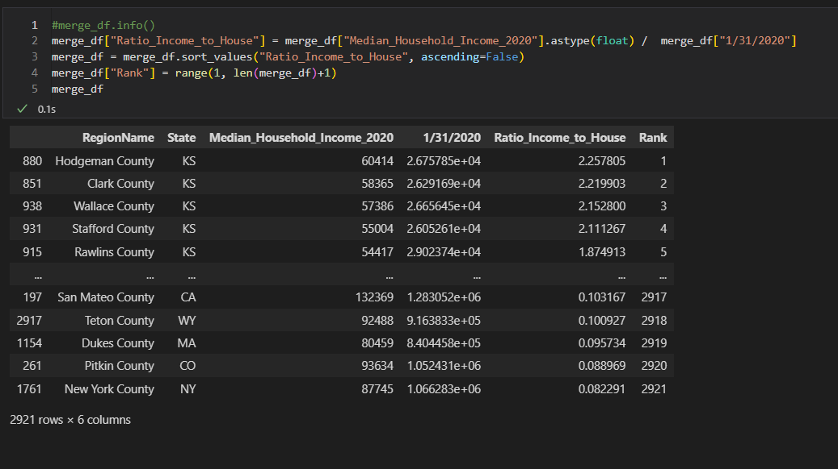
Cleaning Data

Slide 4
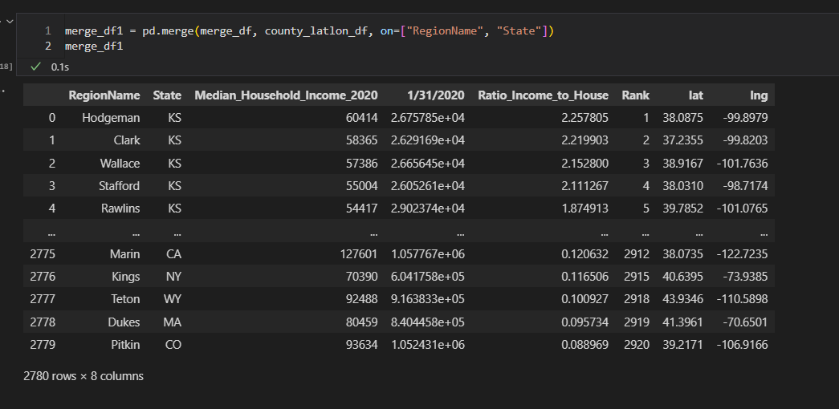

Merging/API Integration

Slide 5
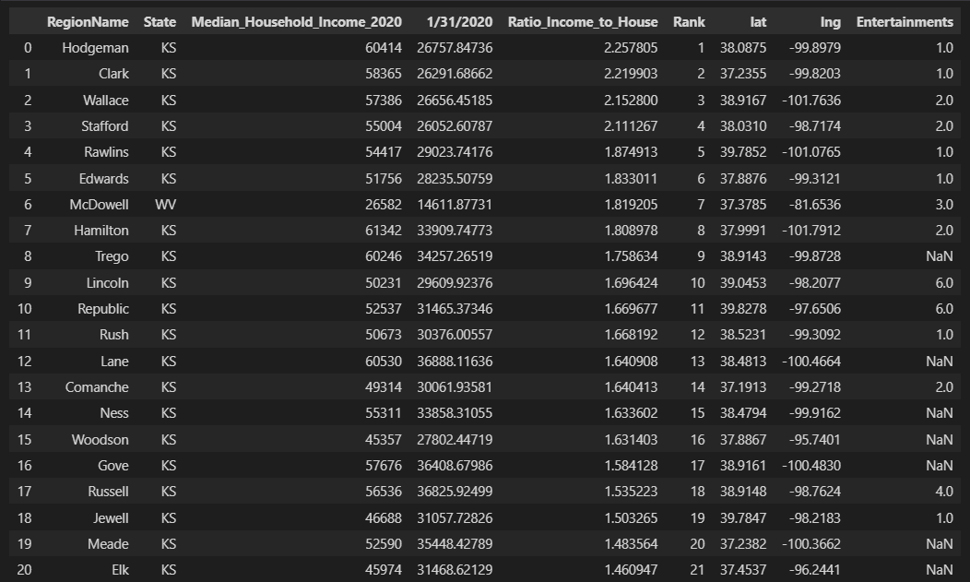
Results

Slide 6
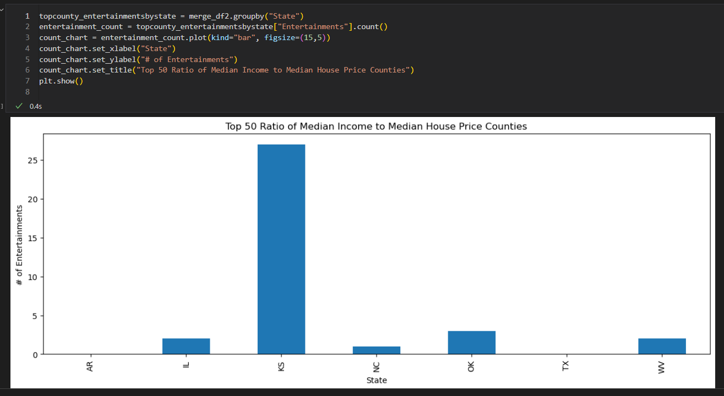
Results

Slide 7
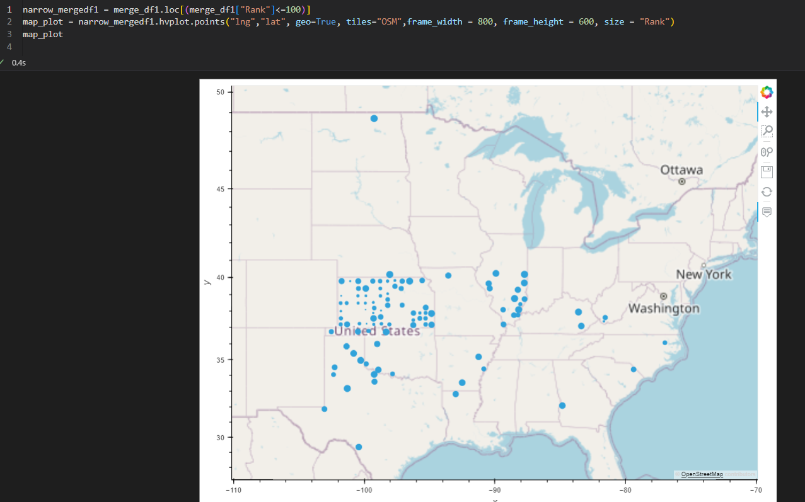
Results

Slide 8
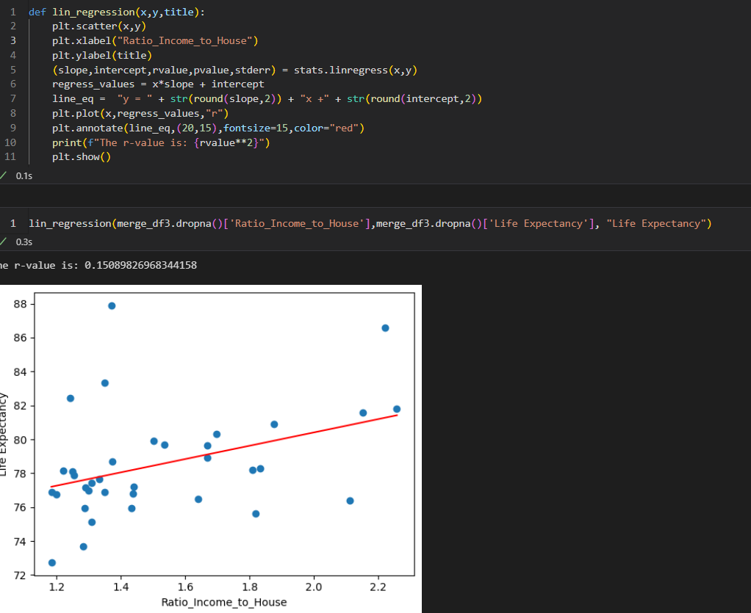
Results

Slide 9
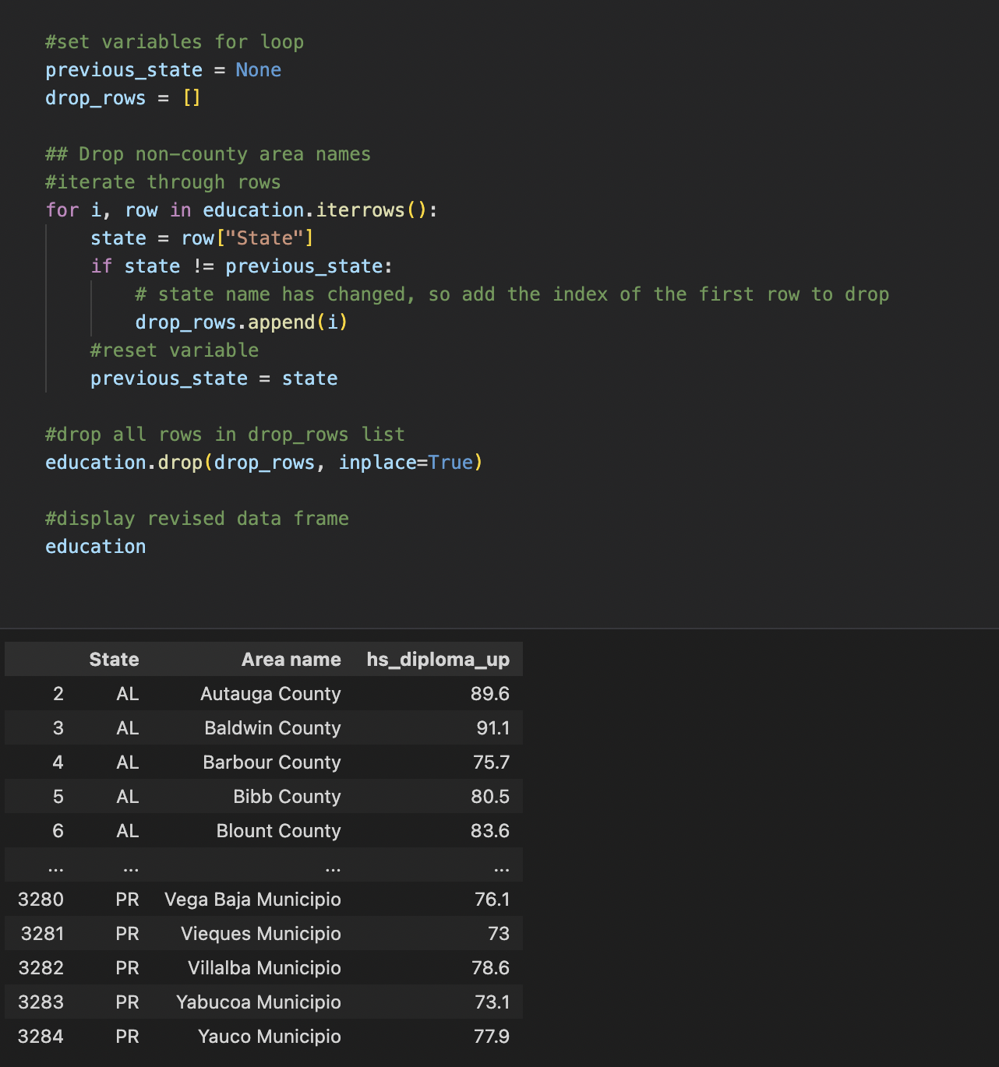
Cleaning education data

Slide 10
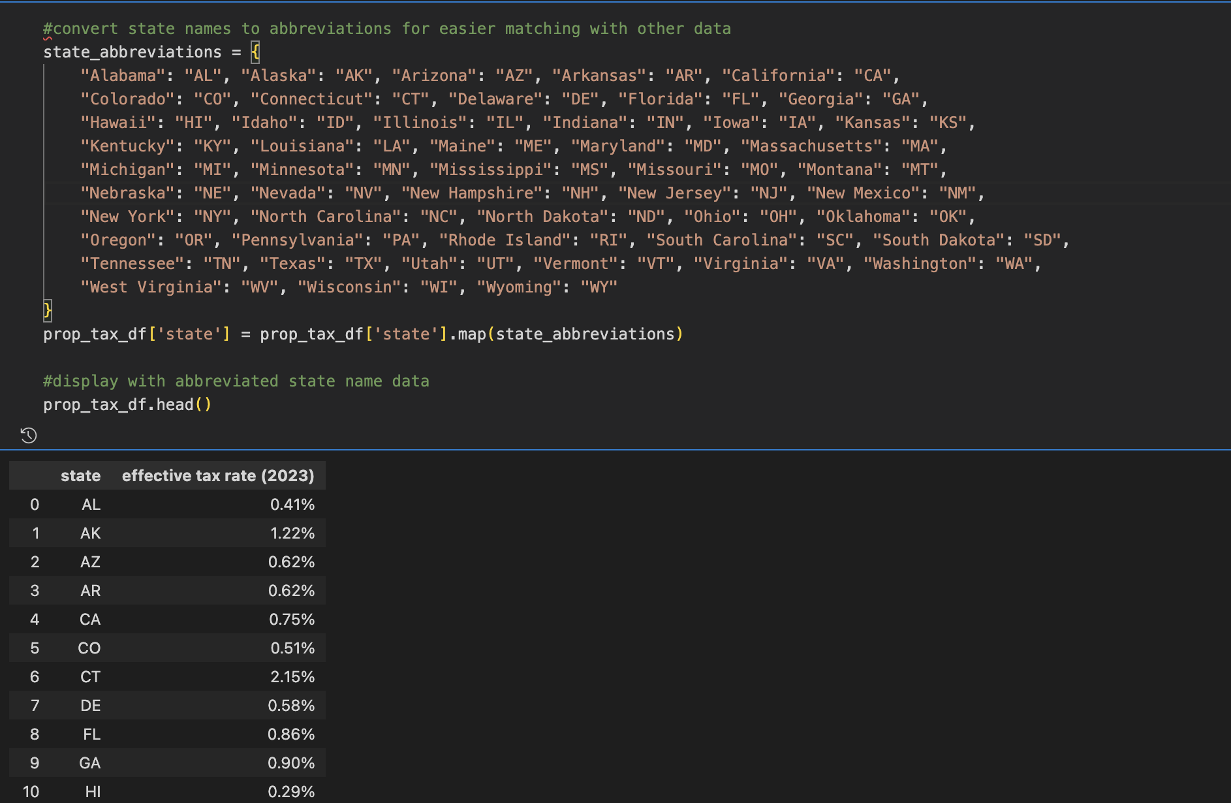
Cleaning property tax data

Slide 11
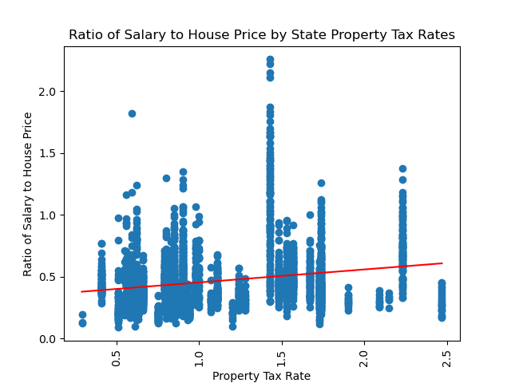
Property tax results
Areas with higher property taxes tend to have a higher ratio of median salary to median home price.

Slide 12
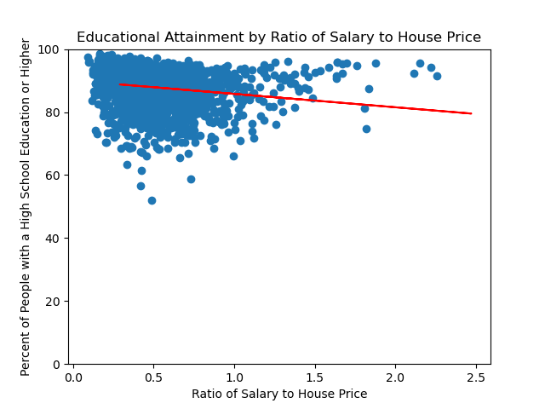
Education Results

Slide 13
Getting Life Expectancy and Sales Tax figures by county
Life expectancy was pretty easy as I was able to locate a good csv that was formatted by county, I only needed to drop some extra columns and stack rank.
Sales Tax was only available by zip code as three things go into the sales tax.
Base of the State sales tax rate.
Add the County Sales Tax.
Add the City Sales Tax.
Add any Special Sales Tax
In order to get the sales tax by county, I had to find a table with zip codes and counties, and merge them.
Once I had them merged by zip, I was able to get an average of all zip codes in a county.
Also, I had to pull 50 sales tax csv tables, one for each state. Then use python to merge them into a single csv file.

Slide 14

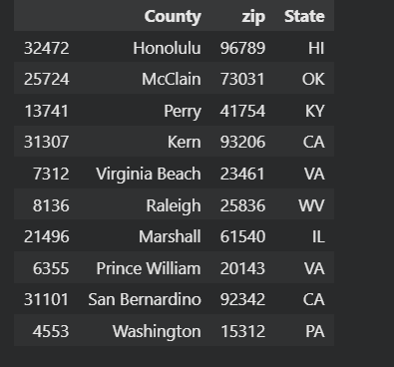

Slide 15

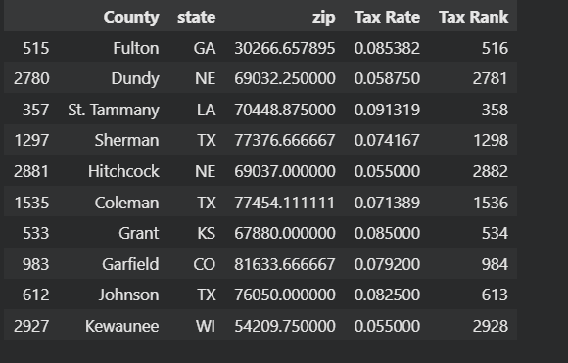
Getting Life Expectancy and Sales Tax figures by county
From here, All I had to do was do some data cleaning and start merging all the ranked tables by county and state.

Slide 16
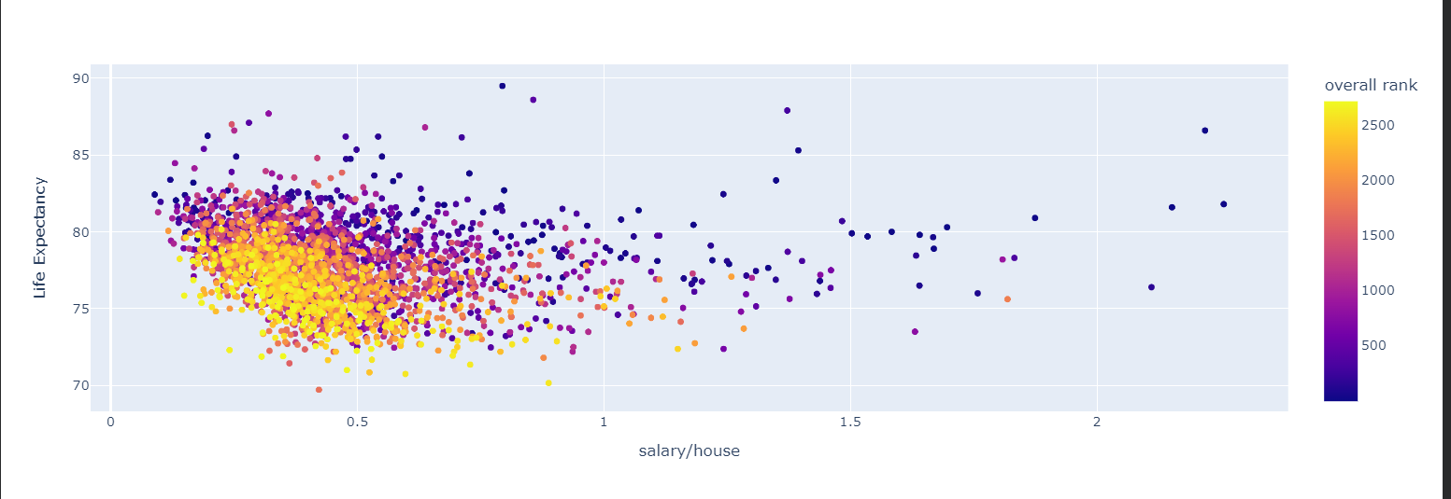
Scatterplot of Life Expectancy vs Salary to Home Price Ratio

Slide 17
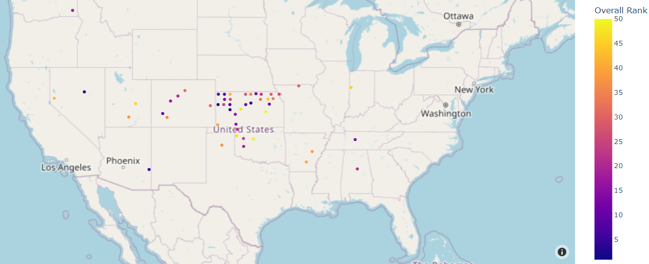
Top 50 counties

Slide 18
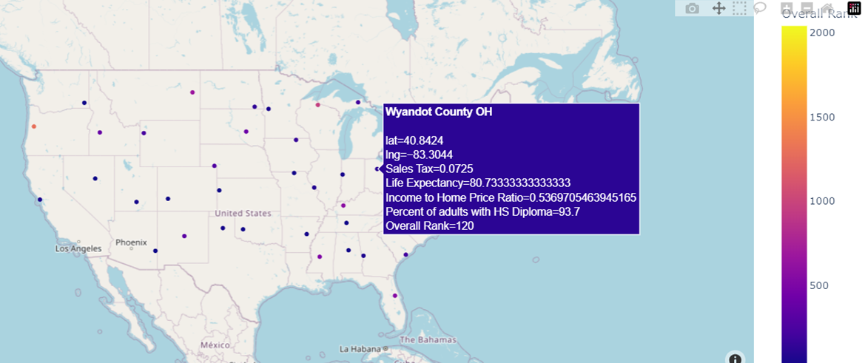
Top County in each State

Slide 19

Top 5 Counties

